Slide 1
UB-CF BASED RECOMMENDER SYSTEMS
Devesh Darshan 2018A5PS0978P
Harshita Gupta 2018A2PS0147P
Hemant Bhartiya 2018A1PS0006P
Ishita Singhal 2018A8PS0349P
Ishanuj Hazarika 2018A2PS0690P

Slide 2
Contribution by each group member
Devesh Darshan : implemented user based collaborative filtering using the above mentioned algorithm on the input file “ratings.csv”
Harshita Gupta : implemented test.py which will take input as a list of test user (already saved in test user.txt) and save output in output.csv as the list of the top-5 recommended movies along with previously seen movies as specified
Implementation of Improvements
Hemant Bhartiya : Using Support Vector Decomposition (SVD) as the predicting Algorithm
Ishita Singhal : Removing movies that have been rated by less than 3 users, Using cosine similarity on the above obtained dataset
Ishanuj Hazarika : Using KNN-algo with pearson similarity and item based collaborative filtering

Slide 3
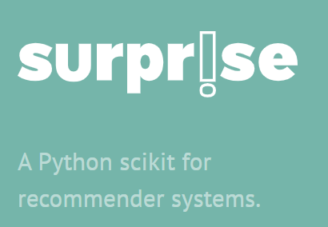
Methodology : SURPRISE- The library
Surprise is a python library used for building and analyzing recommender systems.
This library is the backbone of our model. It provides various built-in prediction algorithms and similarity measures (like Pearson, cosine).

Slide 4
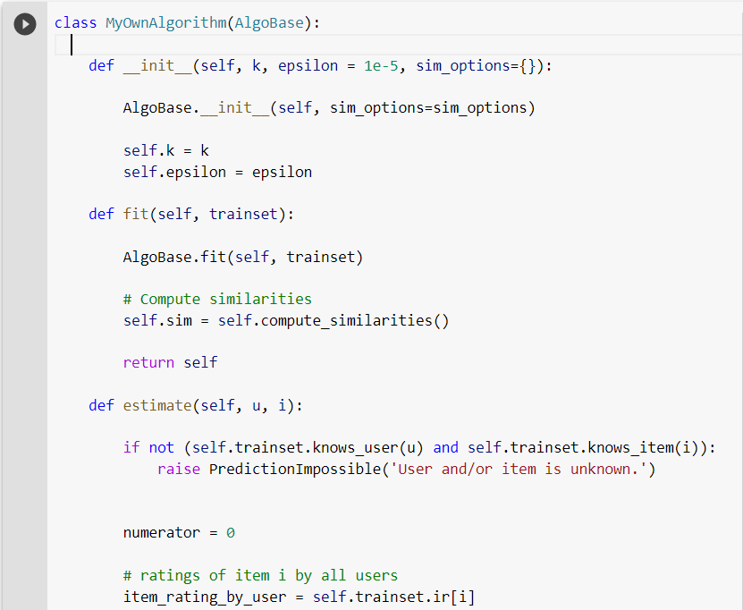
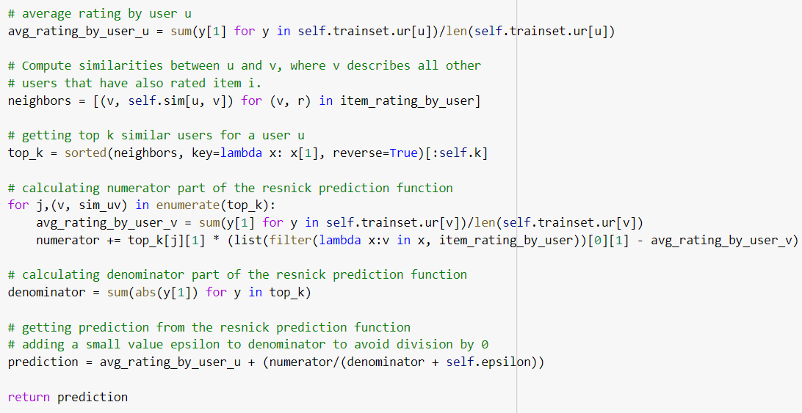
Building our own prediction model using surprise
For building our own prediction model using surprise, we -
constructed a class derived from ‘AlgoBase’ that has an ‘estimate’ method. We defined our Resnick prediction formula using this class.

Slide 5
Contd.
constructed a function for k-fold cross validation using which we obtained MAE scores for different folds.
selected a similarity measure (Pearson) and read the input file with the help of the ‘Reader’ object. This object helps us to define the range of our ratings.

Slide 6
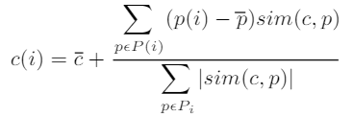
Resnick Prediction Formula
The Resnick prediction formula predicts the ratings in a way that more similar neighbours have greater impact on the final rating.

Slide 7
Algorithm
The similarity measure of the users were calculated using Pearson Correlation coefficient. The neighbourhood selection criteria was based on Top-N user approach.
Prediction of ratings for a target user using for an unseen movie was calculated using Resnick Prediction formula as mentioned in the previous slide.

Slide 8
Evaluation and Testing:
saved the original ratings file from the MovieLens dataset as ori_ratings.csv
created test_user.txt file with 10 randomly selected user ids and removed this user ids from the original ratings file
excluded those users and saved as ratings.csv which was used for evaluation purposes

Slide 9
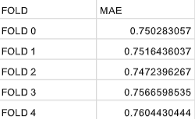
Model evaluation
We implemented user based collaborative filtering using the above mentioned algorithm on the input file “ratings.csv”. After fitting the algorithm, for evaluation of the model, we used k-fold (k=5) cross validation scheme and obtained the following mean absolute errors -

Slide 10
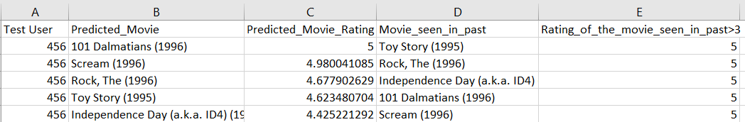
Results
Along with this, we also predicted top-5 movies for 10 randomly chosen users which were not the part of the training phase.
The obtained results are saved in ‘output.csv’ .
For example, for user ID = 456, this is the obtained result :

Slide 11
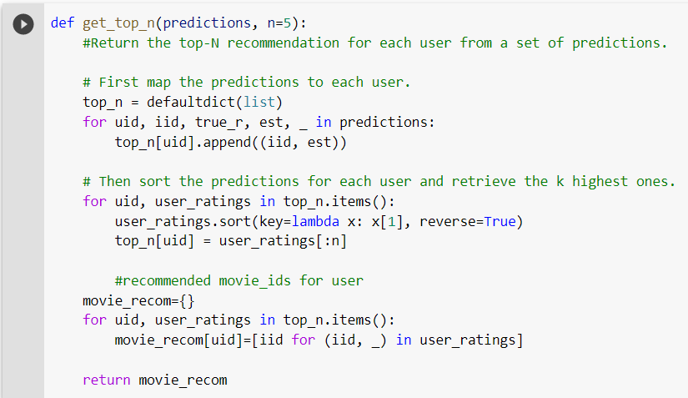
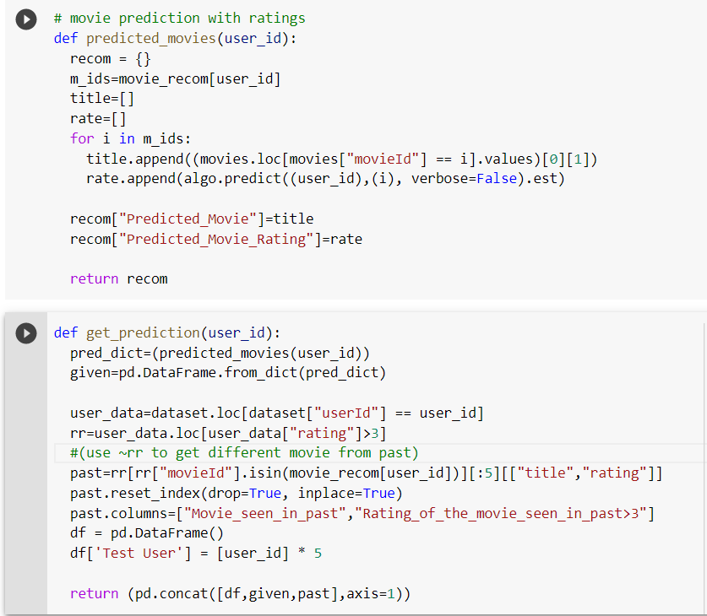
Contd.

Slide 12
Limitations
UBCF is easy to implement and have greater diversity but it faces the following challenges -
Sparsity, as the very less percentage of people rate the items
Cold-start, as for making predictions for a new user ,we have almost no information to find out its neighbours for prediction
More the number of users in our data, more the computational cost for finding nearest neighbours.

Slide 13
Contd.
High maintenance costs, as it requires more frequent computation of user neighbours with the addition of new users.
More space requirements when compared to item based approaches, as generally there are more number of users then the number of items.

Slide 14
Improvements
Removing movies that have been rated by less than 3 users
The probability of a movie being recommended which has been only rated by less than 3 users is very less as it is very less viewed compared to other movies.
This method significantly reduces the sparsity, resulting in better results as well as less time.
Problem with the approach:
This method although reduces the sparsity in the data, but by a very crude way of eliminating data points, hence this method does not use the whole information provided to us.

Slide 15
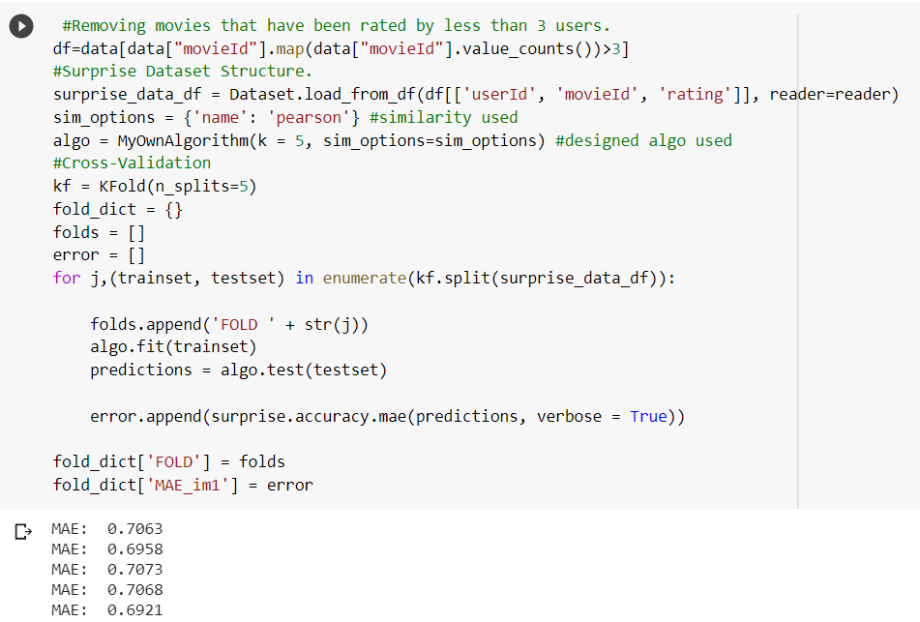
Implementation

Slide 16
Improvements
2. Using cosine similarity on the above obtained dataset
One advantage of cosine similarity is its low-complexity, especially for sparse vectors: only the non-zero dimensions need to be considered.
Smaller cosine angle implies greater similarity between the two users.
In cosine similarity, a subset of a larger data set clusters in the same way it did in the large set, because the data is not centered and normalized again (which is what Pearson would do).
Problem with the approach:
Since it considers only the common ratings between the users, it will not take into account the rating given by a user if it’s unrated by the other and count it as zero.

Slide 17
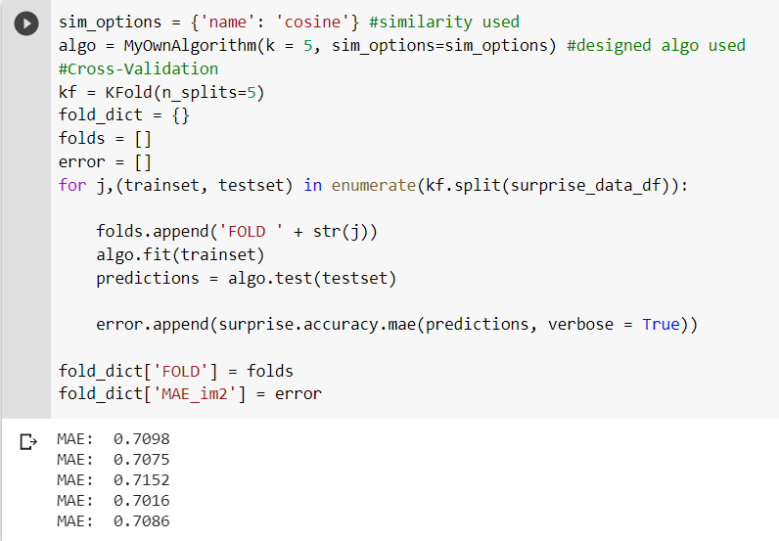
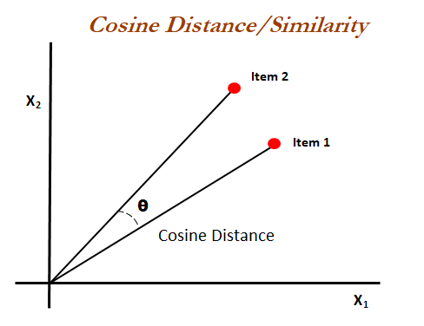
Implementation

Slide 18
Improvements
3. Using KNN-algo with pearson similarity and item based CF
In item based collaborative filtering the ratings are predicted using the user’s own rating on neighbouring items.
Since the ratings are predicted using the rating of users itself, the predicted rating tends to be much more consistent with other ratings of this user.
Item’s neighbourhood changes much slower in comparison to user’s neighbourhood rating
Item based methods are more robust to shilling attacks in the recommender system.
Problem with the approach:
The KNN algorithm for the selection of the similar items takes an additional amount of time while not giving a very satisfactory improvement then the original algorithm.

Slide 19
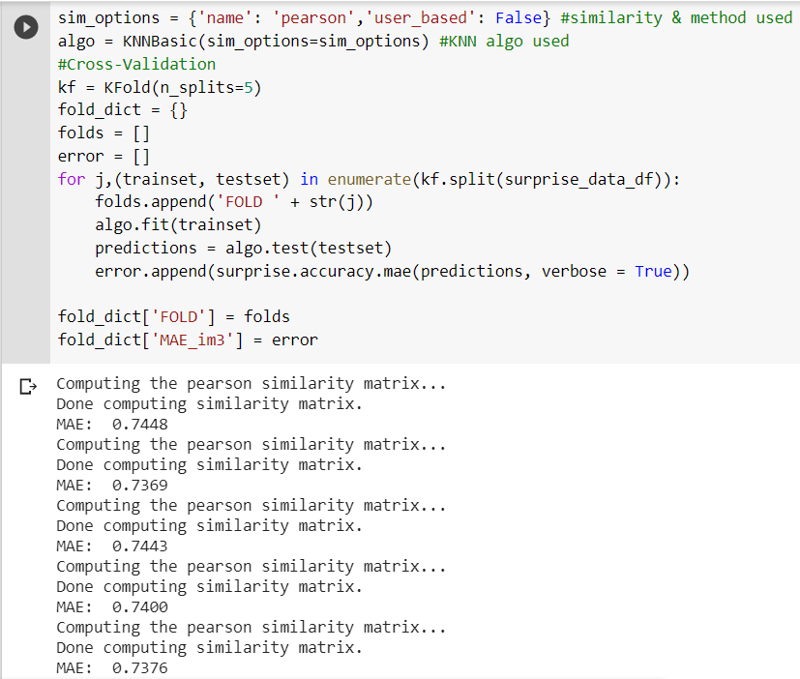
Implementation

Slide 20
Improvements
4. Using Support Vector Decomposition (SVD) as the predicting Algo:
SVD is a matrix factorisation technique, which reduces the number of features of a dataset by reducing the space dimension from N-dimension to K-dimension (where K<N).
The SVD decreases the dimension of the utility matrix A by extracting its latent factors.
Problem with the approach:
Any matrix factorisation method doesn’t take similarity of the items or users into account. The results can be greatly improved by taking similarities into account, which can be done using the Graph Neural Network approach.

Slide 21
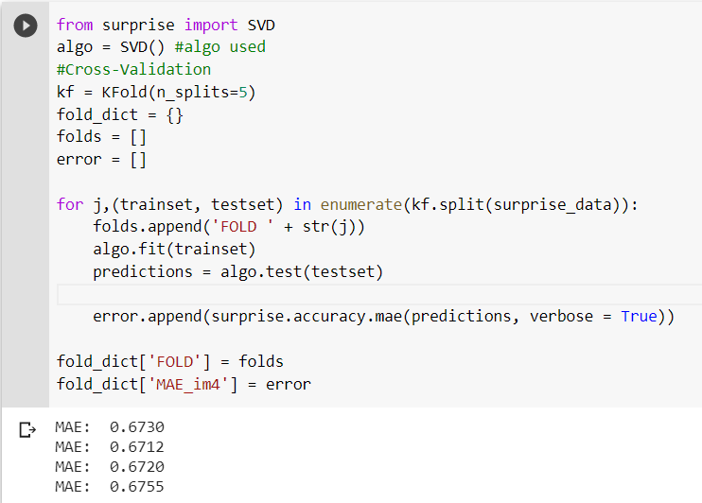
Implementation

Slide 22
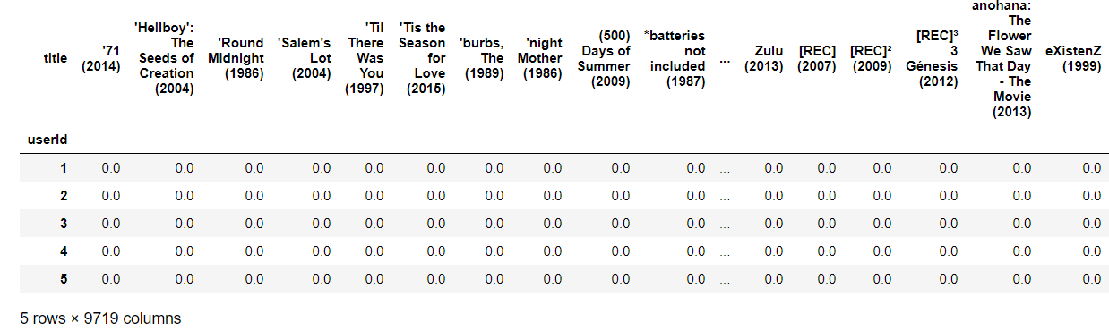
Utility Matrix
Each row corresponds to different users and each column to different movies.
All the movies that a particular user didn’t rate has been filled with a rating of 0.

Slide 23
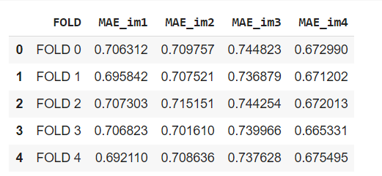
MAE Results:
The MAE results of above mentioned improvements can be seen below:

Slide 24
Thank You

